Slide 1

QUANT TRADING · INTERNSHIP PROJECT 2026
CryptoSight
Quantitative Crypto Trading Platform
Afnan Shoukat
Presenter

Slide 2







OVERVIEW
What is CryptoSight?
An institutional-grade quant platform for crypto markets.
Data Ingestion
158 Indicators
Signal Engine
Backtesting & ML
Live Execution
Sentiment AI

Slide 3




THE CHALLENGE
The Problem
BEFORE
WITH CRYPTOSIGHT
Can't watch charts 24/7
Watches the market 24/7
Too many indicators to track manually
Auto-checks every signal & indicator
Signals missed = opportunities lost
Tests, executes, reports — one dashboard

Slide 4




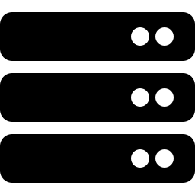
SYSTEM ARCHITECTURE
How It Works
Indicators
& Signals
Live
Execution
Market
Data
Dashboard
Backtest
& ML
Database

Slide 5
MY JOURNEY
What I Learned
Skills gained building CryptoSight from scratch.
Data Engineering
No Future Peeking
ML Pipeline
Clean, reliable market data
Backtests use only past data
From features to predictions
59+ Risk Metrics
Sentiment AI
Live Trading
Sharpe, drawdown & more
Reads market mood from Reddit
Connects to a real exchange

Slide 6


FUTURE VISION
What We Can Add
4 ideas to make CryptoSight even smarter.
AI ENHANCEMENT
AI ENHANCEMENT
AI Strategy Copilot
AI Market Filter
Build strategies by typing in plain English
Spots bad markets and pauses trading
AI ENHANCEMENT
AI ENHANCEMENT
Signal Ranker
Anomaly Detector
Ranks trades by chance of winning
Warns of fake price moves early

Slide 7
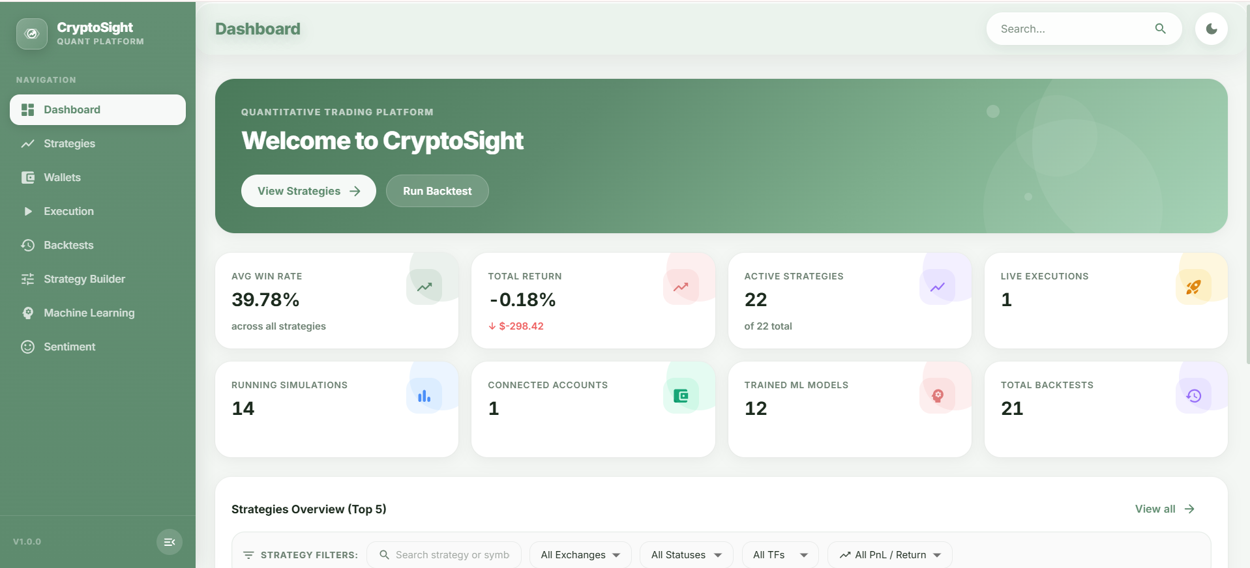
PRODUCT
Dashbaord

Slide 8
CRYPTOSIGHT
Thank You
Questions?
Afnan Shoukat

